Slide 1
Snakemake: Reproducible and Scalable Bioinformatic Workflows
Nathan Watson-Haigh
Bioinformatics Hub
Thur 7th Feb 2019

Slide 2
Resources
Webinar
GitHub repo: https://github.com/UofABioinformaticsHub/2019_EMBL-ABR_Snakemake_webinar
EMBL-ABR YouTube channel: https://www.youtube.com/channel/UC5WlFNBSfmt3e8Js8o2fFqQ
Snakemake
Documentation: https://snakemake.readthedocs.io/
Wrappers: https://snakemake-wrappers.readthedocs.io/
Citation: http://bioinformatics.oxfordjournals.org/content/28/19/2520

Slide 3
Usual Pipeline Paradigm
Working on a Linux cluster with some sort of resource management system
Slurm
PBS
SGE
Others
Pipeline consists of a single (or small number of) script(s) submitted to the cluster
Commonly find that they each:
Do more than one task – read QC, read trimming, read alignment etc
Executes commands in serial
Use loops to iterate over files
Not easy to:
Ensure commands complete successfully before continuing with a dependant task
Get resource requirements right – end up over specifying CPU and memory
Rerun parts of a pipeline – end up commenting out lines of code

Slide 4
Usual Pipeline Paradigm
# CPUs
Consequences
Job waiting in queue for resources
Idle/unused resources
Delays in getting results
Mem
Time
Individual processes/commands
Idle/unused compute resources
Resources requested for script

Slide 5
Why Workflow Management?
Workflow management takes care of the following, so you don’t have to:
Parallelisation
Suspend/resume
Logging
Data provenance
Need to break pipelines down into individual tasks. Think UNIX philosophy which was summarized by Peter H. Salus in A Quarter-Century of Unix (1994) – emphasis is my own:
Write programs (tasks) that do one thing and do it well
Write programs (tasks) to work together

Slide 6
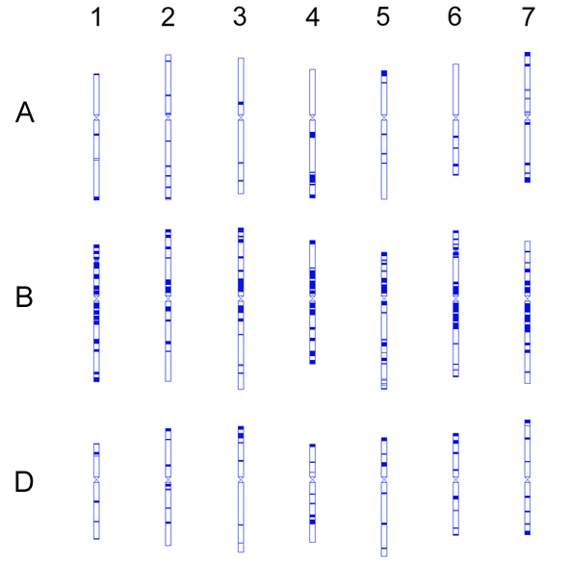
My Drivers for using Snakemake
Analyses in wheat (16Gbp and hexaploid) are time-consuming
Parallelisation - get the job done faster
Resume/continue - only redo what needs to be done
Efficient HPC resource utilisation/specification - avoid waiting in queues
Data provenance – a record of what was done
Reproducibility – others can check/reuse my workflows

Slide 7
Snakemake Paradigm
Decompose workflow into individual rules
Rules define how to create output files from input files
Snakemake infers a dependencies and execution order from the rules
Rule name
rule mytask:
input:
ref = "reference.fasta",
r1 = "reads/my_r1.fastq.gz",
r2 = "reads/my_r2.fastq.gz",
output:
"mapped/my.bam",
shell:
"""
bwa mem {input.ref} {input.r1} {input.r2} \
| samtools view -b > {output}
"""
Input file(s)
Output file(s)
How to create output from the input

Slide 8
Targets
You tell Snakemake what files (targets) to create. Snakemake figures out how to create them by using a dependency graph generated from the rules
By default Snakemake executes the first rule of the Snakefile
This gives rise to pseudo-rules at the beginning of the file that can be used to define build-targets (similar to GNU Make)
Convention to call first rule “all”
Always execute these rule(s) locally, don’t submit to cluster
localrules:
all
rule all:
input:
"mapped/ACBarrie.bam",
"mapped/Alsen.bam",
An expand() here would be a great way to reduce repetition

Slide 9
Targets
You tell Snakemake what files (targets) to create. Snakemake figures out how to create them by using a dependency graph generated from the rules
By default Snakemake executes the first rule of the Snakefile
This gives rise to pseudo-rules at the beginning of the file that can be used to define build-targets (similar to GNU Make)
Convention to call first rule “all”
Expand the pattern using a list of values.
The list can be defined inline (as here) or in the body of the Snakefile.
localrules:
all
rule all:
input:
expand("mapped/{accession}.bam", accession=["ACBarrie", "Alsen"]),

Slide 10
Generalise Rules Using Wildcards
rule mytask:
input:
ref = "reference.fasta",
r1 = "reads/my_r1.fastq.gz",
r2 = "reads/my_r2.fastq.gz",
output:
"mapped/my.bam",
shell:
"""
bwa mem {input.ref} {input.r1} {input.r2} \
| samtools view -b > {output}
"""

Slide 11
Generalise Rules Using Wildcards
rule mytask:
input:
ref = "reference.fasta",
r1 = "reads/{sample}_r1.fastq.gz",
r2 = "reads/{sample}_r2.fastq.gz",
output:
"mapped/{sample}.bam",
shell:
"""
bwa mem {input.ref} {input.r1} {input.r2} \
| samtools view -b > {output}
"""
This rule now knows how to make:
"mapped/my_sample.bam"
"mapped/another_sample.bam"
"mapped/any_sample.bam"

Slide 12
External Scripts
rule mytask:
input:
"path/to/input/file",
output:
"path/to/output/file",
script:
"path/to/script.py"
rule mytask:
input:
"path/to/input/file",
"path/to/other/inputfile"
output:
"path/to/output/file",
somename = "path/to/another/outputfile"
run:
for f in input:
...
with open(output[0], "w") as out:
out.write(...)
with open(output.somename, "w") as out:
out.write(...)
X
Supports:
Python
R
R Markdown
run is for Python code. Use script instead for Python code
run can’t be used with benchmark
run can’t be used with conda

Slide 13
Wrappers
rule mytask:
input:
bam = "mapped/{sample}.bam",
ref = "genome.fasta"
output:
gvcf = "calls/{sample}.g.vcf",
wrapper:
"0.31.1/bio/gatk/haplotypecaller"
Tool wrapper repository:
https://snakemake-wrappers.readthedocs.io/

Slide 14
Common-Workflow Language (CWL)
rule samtools_sort:
input:
input = "mapped/{sample}.bam"
output:
output_name = "mapped/{sample}.sorted.bam"
params:
threads = lambda wildcards, threads: threads,
memory = "4G"
threads:
8
cwl:
"https://github.com/common-workflow-language/workflows/blob/fb406c95/tools/samtools-sort.cwl"
For reproducibility, use a URL with a commit hash
Using CWL imposes additional restrictions on how input, output and params are specified

Slide 15
Installation
Recommended path is using conda
# Load the Anaconda3 module on your cluster
# If it's unavailable contact the cluster sysadmin
module load \
Anaconda3
# Create a new conda environment for snakemake v5.4.0 (currently
# the latest version)
# https://anaconda.org/search?q=snakemake
conda create \
--name snakemake \
--channel bioconda --channel conda-forge \
--yes \
snakemake=5.4.0

Slide 16
Activate Snakemake Environment
# Load the Anaconda3 module on your cluster
# If it's unavailable contact the cluster sysadmin
module load \
Anaconda3
# activate the conda environment you created before
source activate snakemake

Slide 17
Example Workflow
# Clone the repo
git clone https://github.com/UofABioinformaticsHub/2019_EMBL-ABR_Snakemake_webinar
cd 2019_EMBL-ABR_Snakemake_webinar/snakemake-tutorial

Slide 18
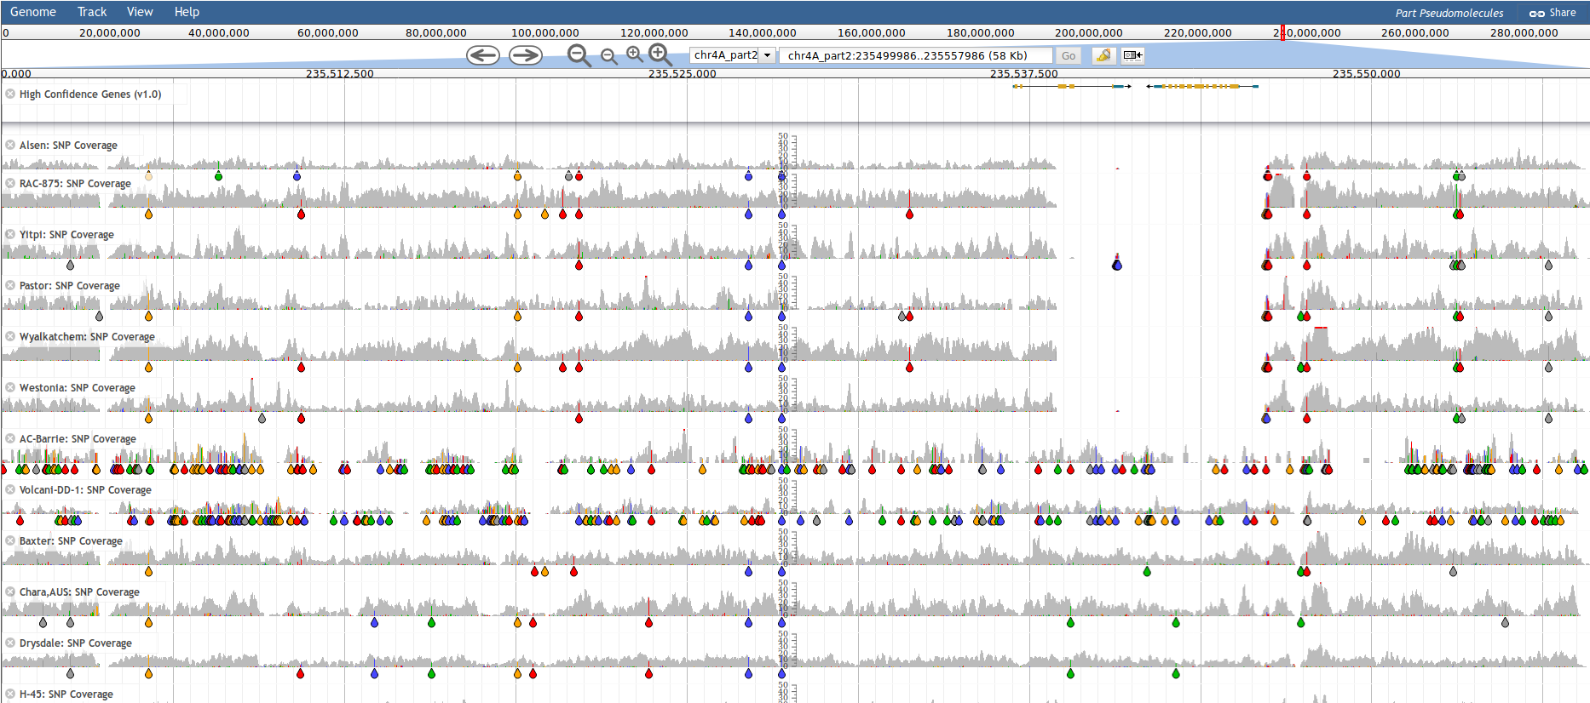
A 58 Kbp region on the long arm of wheat chromosome 4A (~745 Mbp). Several accession contain a deletion relative to the Chinese spring reference. This deletion affects 2 genes, one being Wx-B1 (or “Waxy”). Waxy genes are solely responsible for amylose synthesis in wheat and high amylose content is associated with low noodle quality. DAWN Reference: 10.1186/s12864-018-5228-2

Slide 19
Example Workflow
# Clone the repo
git clone https://github.com/UofABioinformaticsHub/2019_EMBL-ABR_Snakemake_webinar
cd 2019_EMBL-ABR_Snakemake_webinar/snakemake-tutorial
# Generate DAG of job dependencies
snakemake \
--dag \
| dot -Tsvg \
> dag.svg

Slide 20
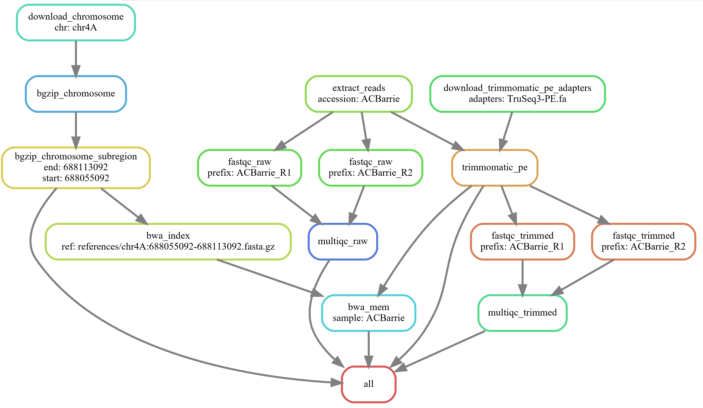
DAG of Jobs
A job
Rule name
A single accession
Wildcard name:value
Job dependency
Target

Slide 21
Example Workflow
# Clone the repo
git clone https://github.com/UofABioinformaticsHub/2019_EMBL-ABR_Snakemake_webinar
cd 2019_EMBL-ABR_Snakemake_webinar/snakemake-tutorial
# Generate DAG of job dependencies
snakemake \
--dag \
| dot -Tsvg \
> dag.svg
# See what rules and commands would be executed
snakemake \
--dryrun --printshellcmds
# Submit workflow to cluster and use conda software environment inside a Singularity container
module load \
Singularity
snakemake \
--profile profiles/slurm \
--cluster-config cluster-configs/default.yaml \
--cluster-config cluster-configs/phoenix.yaml \
--use-singularity --use-conda

Slide 22
Add a New Accession
# Add "Alsen" to the ACCESSIONS array:
ACCESSIONS = [
"ACBarrie",
"Alsen",
]
# Generate DAG of job dependencies
snakemake \
--dag \
| dot -Tsvg \
> dag2.svg

Slide 23
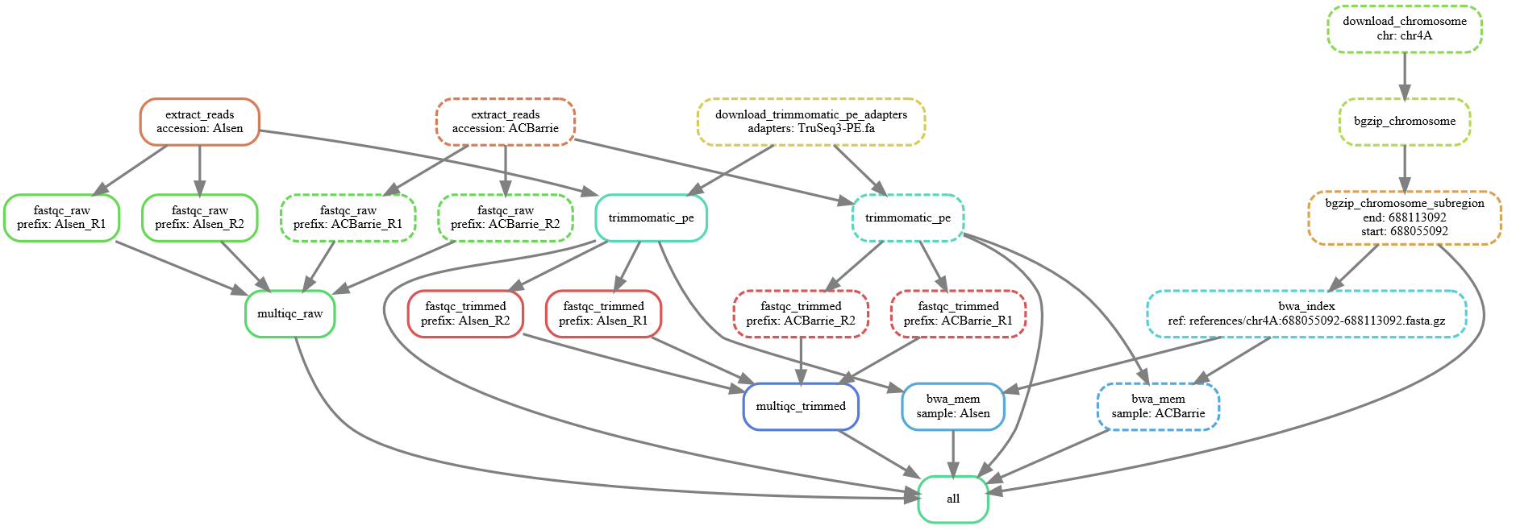
DAG of Jobs: Updated
New accession
Dashed = job completed
Solid = job needs running
Same node colour = same rule

Slide 24
Add a Bunch of Accessions
# Add more accessions to ACCESSIONS array:
ACCESSIONS = [
"ACBarrie",
"Alsen",
"Baxter",
"Chara",
"Drysdale",
"Excalibur",
"Gladius",
"H45", "Kukri", "Pastor", "RAC875", "Volcanii", "Westonia", "Wyalkatchem", "Xiaoyan", "Yitpi",
]
# Generate DAG of job dependencies
snakemake \
--dag \
| dot -Tsvg \
> dag3.svg

Slide 25
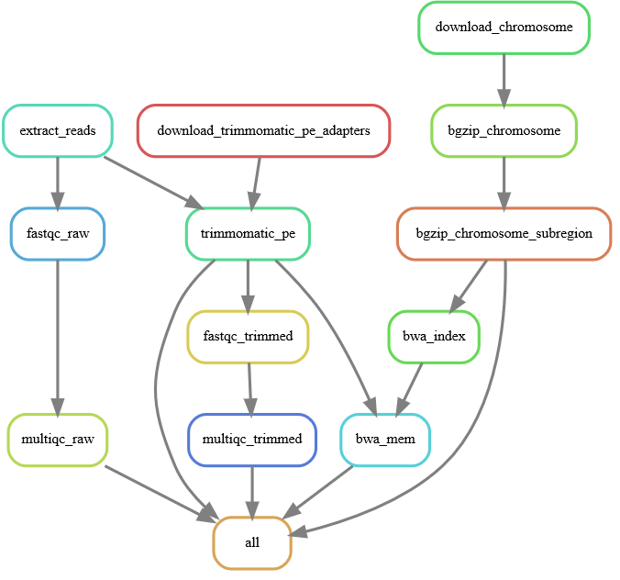
DAG of Rules
# Generate DAG of rules
snakemake \
--rulegraph \
| dot -Tsvg \
> rulegraph.svg
# Get a count of all jobs that would be run
snakemake \
--dryrun \
--quiet
Job counts:
count jobs
1 all
15 bwa_mem
15 extract_reads
30 fastqc_raw
30 fastqc_trimmed
1 multiqc_raw
1 multiqc_trimmed
15 trimmomatic_pe
108

Slide 26
Job Software Execution Environment
Jobs executed by Snakemake expect the software environment to “just work”
E.g. commands present in the shell section are expected to be on the PATH
Snakemake can make use of conda for a reproducible software environment
Use the conda keyword in rules to specify the location of a conda environment file
Use the --conda command line argument to instruct Snakemake to use them
channels:
- bioconda
- conda-forge
- defaults
dependencies:
- fastqc=0.11.8
- multiqc=1.7
- trimmomatic=0.36
- pigz=2.3.4
- bwa=0.7.17
- samtools=1.9
- htslib=1.9
- unzip=6.0
rule bwa_mem :
input: ...
output: ...
conda:
"envs/tutorial.yml"
shell: ...
Can use rule-specific conda environments
Search Anaconda Cloud for available tools/versions

Slide 27
Summary
# CPUs
Mem
Time
Before
After

Slide 28
Resources
Webinar
EMBL-ABR YouTube channel: https://www.youtube.com/channel/UC5WlFNBSfmt3e8Js8o2fFqQ
GitHub repo: https://github.com/UofABioinformaticsHub/2019_EMBL-ABR_Snakemake_webinar
Snakemake
Documentation: https://snakemake.readthedocs.io/
Wrappers: https://snakemake-wrappers.readthedocs.io/
Citation: http://bioinformatics.oxfordjournals.org/content/28/19/2520

Slide 29
Advanced Features

Slide 30
Rule Resources
Jobs submitted to the cluster are all getting the same default resources
The slurm profile (profiles/slurm) together with cluster-config files determine what resources each job gets
# Reminder on how we’re submitting workflow jobs to a cluster
snakemake \
--profile profiles/slurm \
--cluster-config cluster-configs/default.yaml \
--cluster-config cluster-configs/phoenix.yaml \
--use-conda
cluster-configs/default.yaml file sets some default cluster configuration values
cluster-configs/phoenix.yaml file overrides some of those values for my specific Slurm cluster

Slide 31
Rule Resources: default.yaml
__default__ :
job-name : "{rule}"
output : "logs/{rule}/{wildcards}.out"
ntasks : 1
cpus-per-task : 1
mem : "200M"
time : "00-00:05:00"
account : "my_account"
partition : "my_partition"
# Override the above defaults, with job specific values
bwa_mem :
cpus-per-task : 16
mem : "10000M"
time : "00-01:00:00"

Slide 32
Rule Resources: resources keyword
# Job specific resource requirements can be passed from the rule, in
# the Snakefile, itself via the "resources" keyword
bwa_mem :
cpus-per-task : 4
mem : "{resources.mem_mb}M"
time : "00-00:{resources.time_mins}:00"
rule bwa_mem :
input: ...
output: ...
resources:
mem_mb = 10000,
time_mins = 60,
shell: ...
Resources must be integers

Slide 33
Rule Resources: Dynamic Scaling
Lambda (anonymous) functions
Signature: callable(wildcards [, input] [, threads] [, attempt])
Restricted to a single expression – can easily get ugly (see next slide)
Simple way to scale up resources on each job retry attempt
Can get more complex by access information about input files (e.g. their size), number of threads being used
rule bwa_mem :
input: ...
output: ...
resources:
mem_mb = lambda wildcards, attempt: 10000 * attempt,
time_mins = lambda wildcards, attempt: 60 * attempt,
shell: ...
attempt | mem_mb | time_mins
1 | 10000 | 60
2 | 20000 | 120
Scales memory and time linearly with attempt number

Slide 34
Rule Resources: Dynamic Scaling
For each job restart (attempt) add an additional 10%
Round up to nearest integer
rule bwa_mem :
input: ...
output: ...
resources:
mem_mb = lambda wildcards, attempt: math.ceil(10000 * (1+(attempt-1)/10)),
time_mins = lambda wildcards, attempt: math.ceil(60 * (1+(attempt-1)/10)),
shell: ...
attempt | mem_mb | time_mins
1 | 10000 | 60
2 | 11000 | 66

Slide 35
Rule Resources: Dynamic Scaling with Input Size
import os
rule myrule :
input: index = ...,
...
output: ...
resources:
mem_mb = lambda wildcards, input, attempt: math.ceil( sum(os.path.getsize(f) for f in input['index'] if os.path.isfile(f)) / 1024**2*(1+(attempt-1)/10)),
shell: ...
Sum of input.index file size(s) in Mbytes
For each job restart (attempt) add an additional 10%
Round up to nearest integer

Slide 36
Python Globbing
Snakefiles can contain arbitrary Python code
Rather than maintaining a hard-coded list of accessions/samples, have a consistent directory structure that you parse for this information
The ideal place to do this is from your raw data
ACCESSIONS,R, = glob_wildcards('raw_reads/{accession,[^/]+}_R{r,[12]}.fastq.gz')
# ACCESSIONS = ['Alsen', 'ACBarrie', 'Alsen', 'ACBarrie']
# R = ['2', '2', '1', '1']
ACCESSIONS = set(ACCESSIONS)
# ACCESSIONS = {'Alsen', 'ACBarrie'}

Slide 37
Benchmarking
Snakemake can generate benchmark info for executed jobs using the benchmark keyword
The repeat() function allows one to specify the number of replicate benchmarks to run
Benchmark repeats are run from within the same cluster job, therefore, don’t forget to scale the job times accordingly
N_BENCHMARKS = 3
rule bwa_mem :
input: ...
output: ...
benchmark:
repeat("benchmarks/bwa_mem/{prefix}.txt", N_BENCHMARKS),
shell: ...

Slide 38
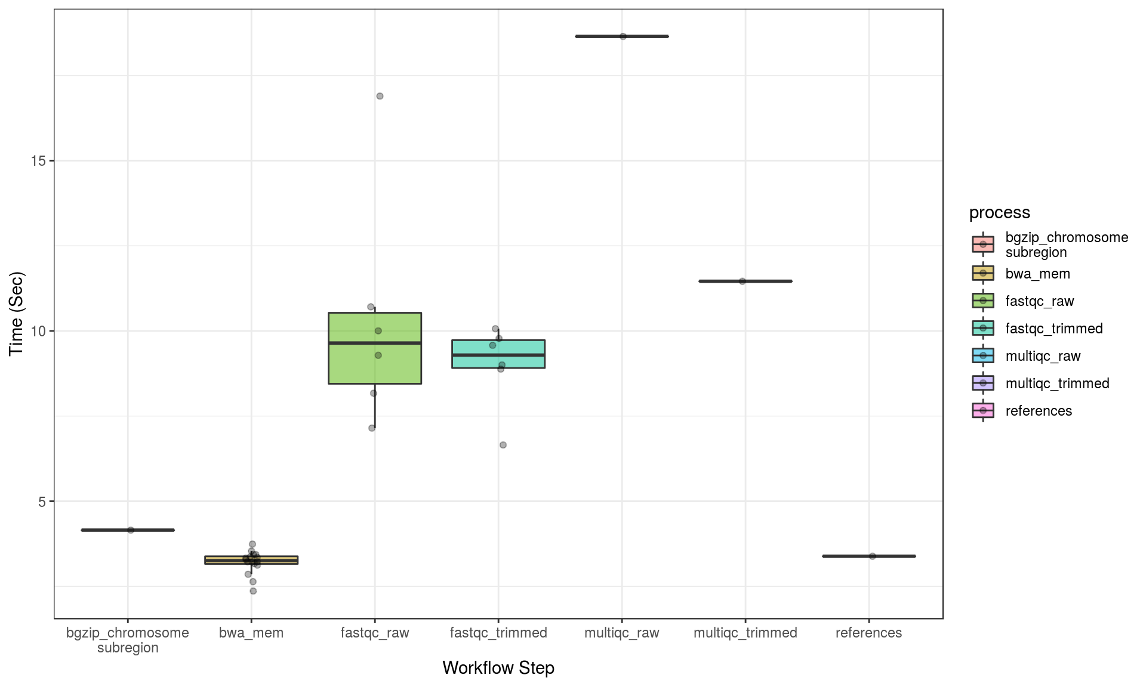
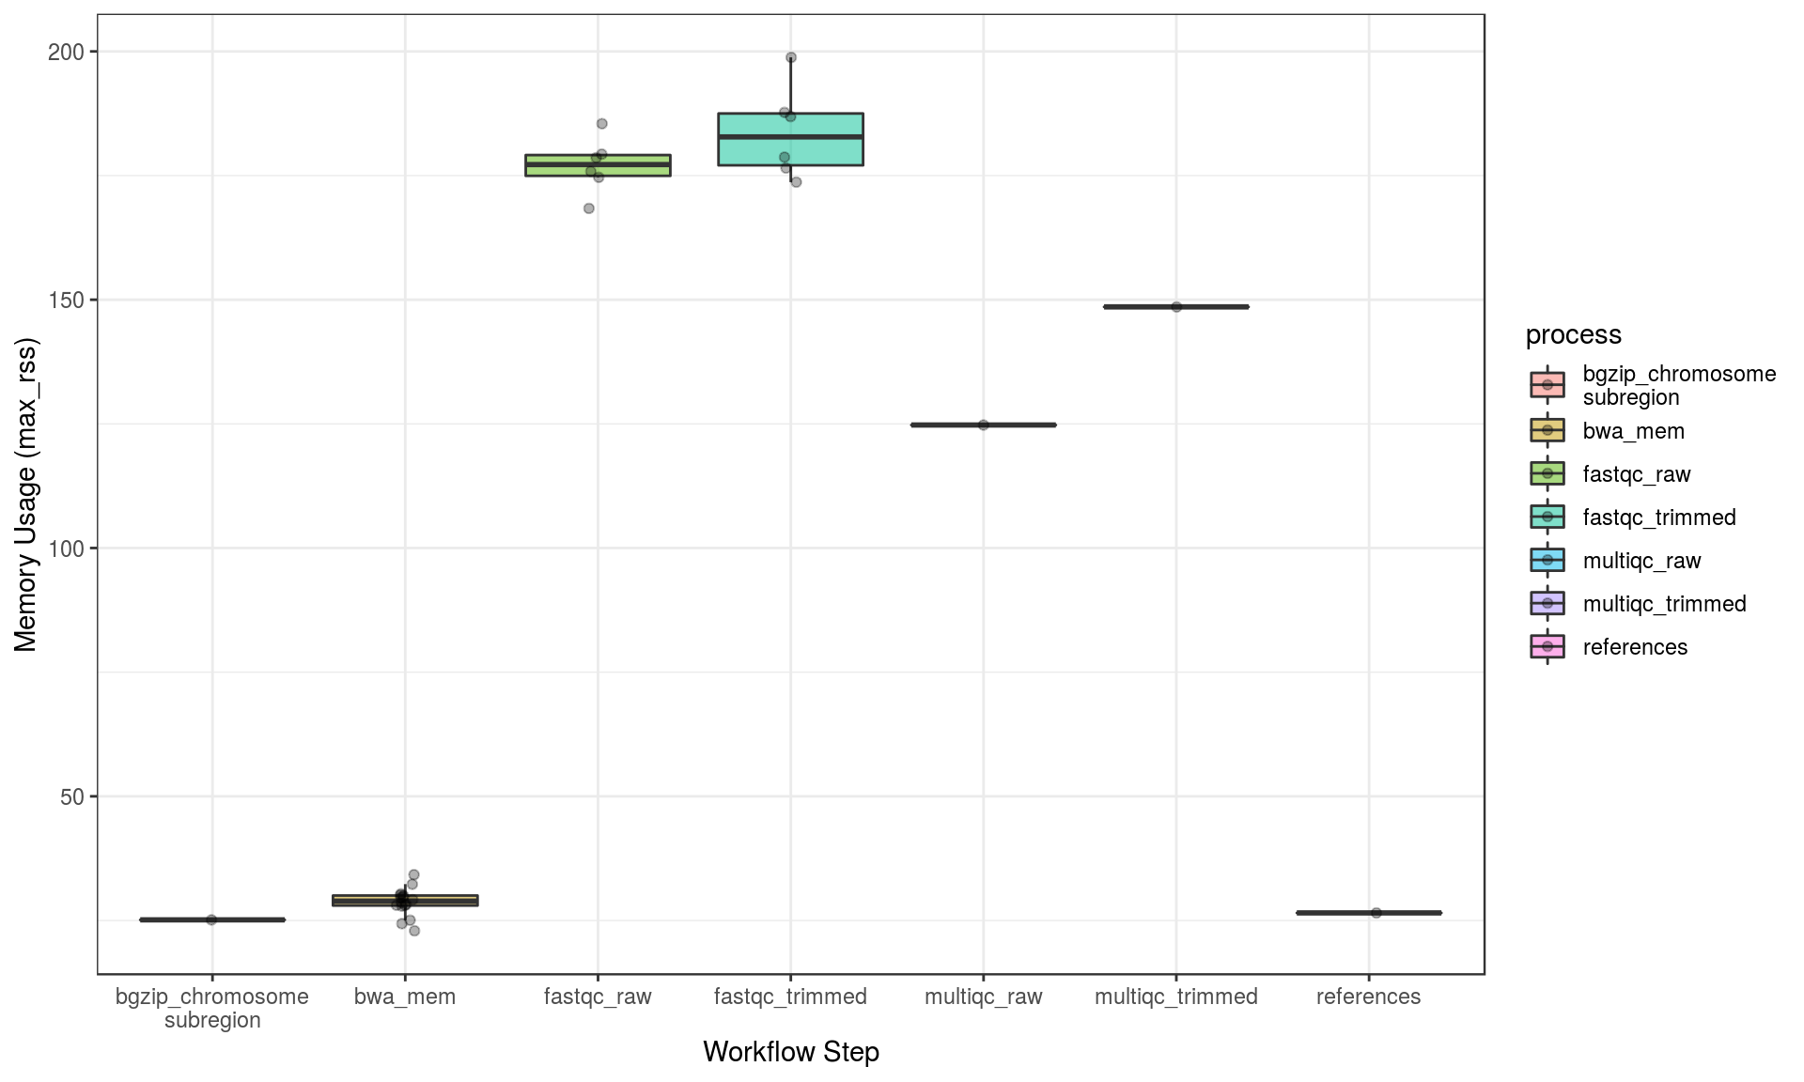
Benchmarking
Thanks to Steve Pederson for R Markdown to plot the benchmark stats

Slide 39
Containers for Reproducibility
Snakemake can use docker or singularity containers. Just specify --use-singularity
These can be specified for each rule, using the singularity keyword
rule NAME:
input:
"table.txt"
output:
"plots/myplot.pdf"
singularity:
"docker://joseespinosa/docker-r-ggplot2"
script:
"scripts/plot-stuff.R"
docker:// → https://hub.docker.com/
shub:// → https://singularity-hub.org/

Slide 40
Containers for Reproducibility
Snakemake can use docker or singularity containers. Just specify --use-singularity
These can be specified for each rule, using the singularity keyword
Or globally for every rule to use
singularity:
"docker://joseespinosa/docker-r-ggplot2"
rule NAME:
input:
"table.txt"
output:
"plots/myplot.pdf"
script:
"scripts/plot-stuff.R"

Slide 41
Containers for Reproducibility
Snakemake can use docker or singularity containers. Just specify --use-singularity
These can be specified for each rule, using the singularity keyword
Or globally for every rule to use
Conda usage inside a singularity container can be achieved with --use-singularity and --use-conda
singularity:
"docker://continuumio/miniconda3:4.5.12"
rule NAME:
input:
"table.txt"
output:
"plots/myplot.pdf"
conda:
"envs/tutorial.yml"
script:
"scripts/plot-stuff.R"
Minimal software environment e.g. no unzip
Must explicitly set in conda environment

